Slide 1
Cyberbullying
Magnolia High School
W.E.L.D. Program - Cybersecurity Lesson

Slide 2
Unless and until our society recognizes cyberbullying for what it is, the suffering of thousands of silent victims will continue.”
Anne Maria Chavez

Slide 3
DEFINITIONS
What is Bullying?
Bullying is unwanted, aggressive behavior among school aged children that involves a real or perceived power imbalance. The behavior is repeated, or has the potential to be repeated, over time.
In order to be considered bullying, the behavior must be aggressive and include:
An Imbalance of Power: Kids who bully use their power - physical strength, embarrassing information, or popularity - to control or harm others.
Repetition: Bullying behaviors happening more than once or has the potential to happen more than once.
What is Cyberbullying?
Cyberbullying is bullying that takes place over digital devices like cell phones, computers, and tablets. Cyberbullying can occur through SMS, Text, and apps, or online in social media, forums, or gaming where people can view, participate in, or share content.
Cyberbullying includes sending, posting, or sharing negative, harmful, false, or mean content about someone else. It can include sharing personal or private information about someone else causing embarrassment or humiliation.
Some cyberbullying crosses the line into unlawful or criminal behavior.

Slide 4
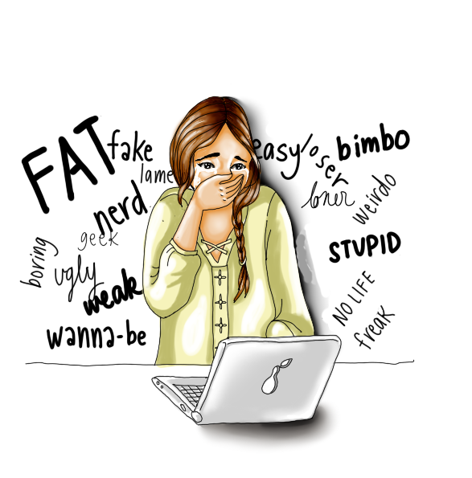
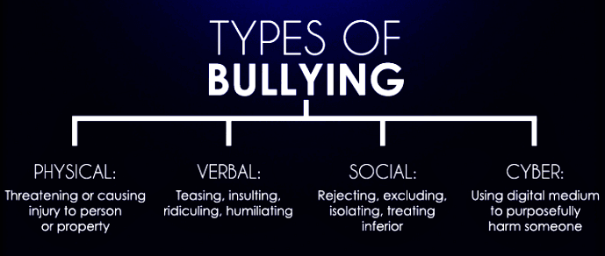
STOP!

Slide 5
PHYSICAL BULLYING
involves hurting a person’s body or possessions
Physical Bullying Includes:
Hitting / Kicking / Pinching
Spitting
Tripping / Pushing
Taking or breaking someone’s belongings
Making mean or rude hand gestures

Slide 6
VERBAL BULLYING
is saying or writing mean or hurtful things.
Verbal Bullying Includes:
Teasing
Name-Calling
Inappropriate sexual comments
Taunting
Threatening to cause harm

Slide 7
SOCIAL
BULLYING
involves hurting someone’s reputation or relationships
Social Bullying Includes:
Leaving someone out on purpose
Telling other students not to be friends with someone
Spreading rumors about someone
Embarrassing someone in public

Slide 8
CYBER
BULLYING
involves intentionally hurting someone in the digital world
Cyberbullying Includes:
Social and Verbal bullying digitally
All social media platforms
Repeatedly committing the same offense
Threats of violence
Stalking and hate crimes

Slide 9
WHAT YOU CAN DO TO PREVENT CYBERBULLYING
Notice
If there is a change in mood or behavior, explore what the cause might be.
Talk
Ask questions to learn what is happening, how it started, and who is involved.
Document
Keep records of what is happening and where. Take screenshots of posts and content for evidence.
Report
Social media platforms have policies in place for reporting incidences. Schools also have policies against bullying. Talk with an adult if you are not sure what to do or where to go.
Support
Peers, mentors, and trusted adults can help. Reach to someone who can intervene into the situation. Let someone know what is happening.
Notes:
For more information see notes included with presentation

Slide 10
HOW TO REPORT
When cyberbullying happens, it is important to document and report the behavior so it can be addressed and stopped.

Slide 11
REPORTING
CYBERBULLYING
Steps to Take Immediately
FIRST STEP
Don’t respond to and don’t forward cyberbullying messages.
SECOND STEP
Keep evidence of cyberbullying. Save screenshots, emails, and text messages.
THIRD STEP
Block the person who is cyberbullying you.
FOURTH STEP
Report cyberbullying to the online service or social media provider.
FIFTH STEP
Report cyberbullying to law enforcement.
SIXTH STEP
Report cyberbullying to school administration.
Notes:
For more information see notes included with presentation

Slide 12
The following groups are listed under California anti-bullying laws and regulations:
Disability
Gender
Gender Identity
Gender Expression
Nationality
Race or Ethnicity
Religion
Sexual Orientation
Association with a person or group with one or more or these actual or perceived characteristics
ANTI-BULLYING LAWS AND REGULATIONS IN CALIFORNIA
Discrimination
Harassment
Intimidation
Bullying

Slide 13
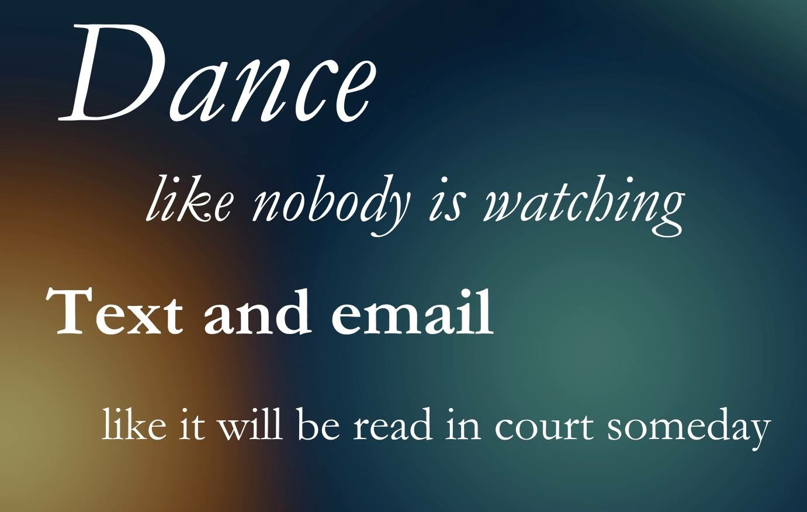
Final Thought
Place your screenshot here

Slide 14
Thanks!
Any questions?

Slide 15
Credits
Special thanks to all the people who made and released these awesome resources for free:
Presentation template by SlidesCarnival
Photographs by Dark Psychology Blog
Photographs by Odyssey
Source information from Stop Bullying
Slide presentation created by Mr. Derbish

